Slide 1

Python & Data Science Training Project 1 – COVID-19 Data Analysis

Slide 2
Purpose of the Study
This project will analysis COVID-19-related data on deaths in the US. Typical questions to ask (or hypotheses to raise in terms of statistics):
1) What are the main conditions associated with COVID-19-related deaths?
2) Any seasonal effects on death?
3) What age groups have shown highest age groups?
4) At the beginning of the pandemic, California and New York show very high number of deaths from COVID-19. Do blue states have higher death rates in general?
5) COVID-19 deaths are often associated with other diseases. How do we get a clean calculation for COVID-19-only deaths?

Slide 3
Python & DS Skills Learned in this Project
- Use pandas and numpy to do the following:
Reading in csv or Excel data to python.
Merging data.
Correlation between variables/columns.
- Use matplotlib and seaborn to visualize data and findings.
- Use geopandas to visualize EV adoption on the US map.
- The principle of A/B testing.
This will be an eye-catching term in your resume.

Slide 4
A/B Testing
A/B Testing is an experimentation process where two or more scenarios (A and B) are compared. We want to find out which scenario is more effective.
Example of a marketing campaign:
- A company launch the following campaigns to send solicitation letters to two groups of customers.
- The two groups of customers are very similar (200,000 were randomly selected for each group)
- The offers to the two groups of customers are the same except
Group A: No cash rebate is offered
Group B: A cash of 1% rebate is offered.
For A/B testing, we want to find out whether the cash rebate can boost the response rate.

Slide 5
Using A/B testing to correctly calculate COVID-19-only deaths
COVID-19-related deaths are often associated with other diseases. Death associated with other diseases should not be attributed to COVID-19. Otherwise the death tolls will be inflated.
How do we calculate COVID-19-only deaths?
Scenario A: # of death without COVID-19 per year (data from 2019)
Scenario B: # of death related to COVID-19 per year (data from 2020, 2021 and/or 2022)
Assuming that COVID-19 is the only additional factor after 2020, we can calculate the following:
COVID-19-only deaths = Scenario B – Scenario A

Slide 6
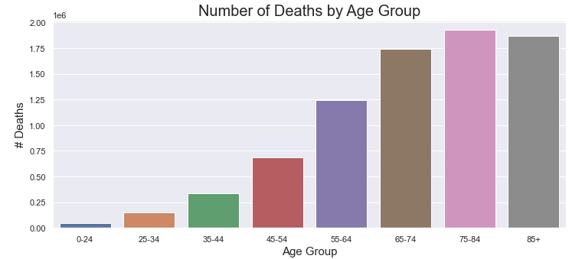
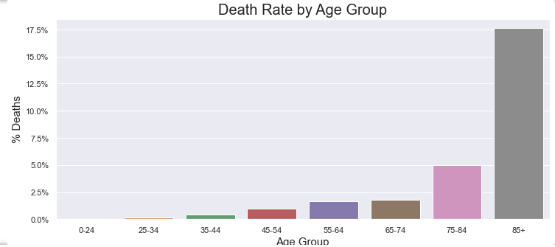
Example of visualization - EV market share increases from red states to purple states and to blue states.

Slide 7
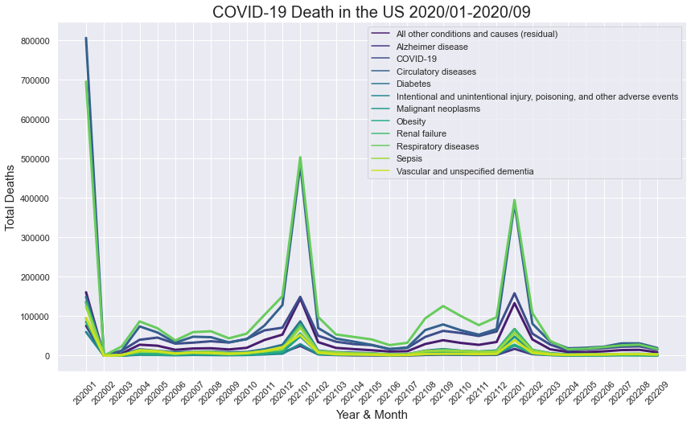
Time-series Analysis

Slide 8
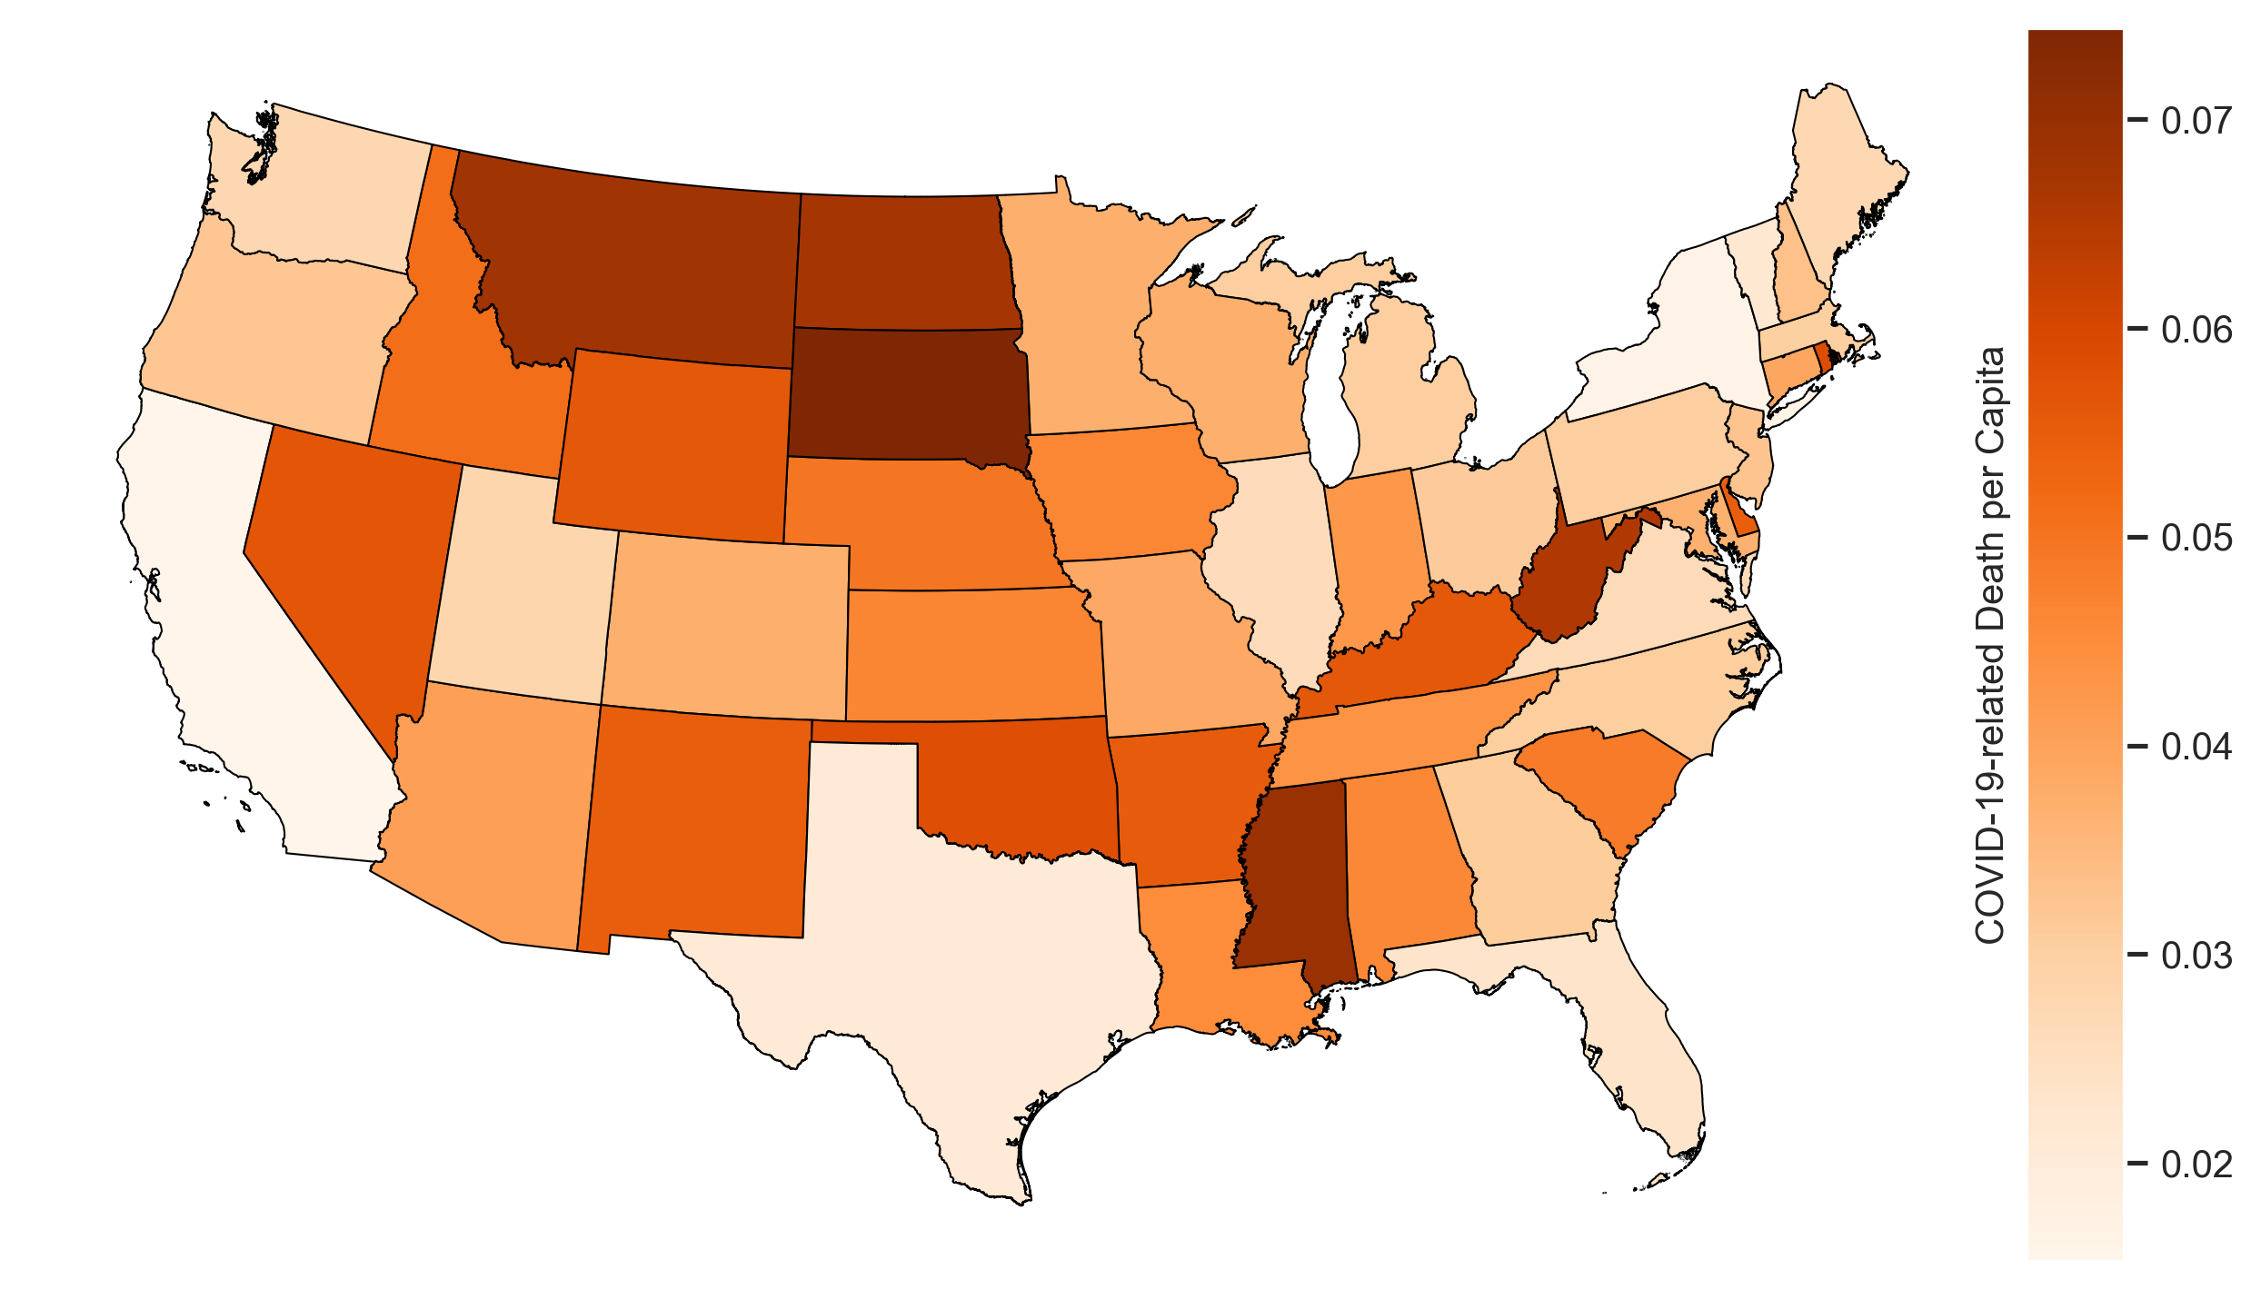
Geo Mapping - Death per capita in the US

